Slide 1
Team 2 - Rideease
Github URL - https://github.com/himanshu8655

Slide 2
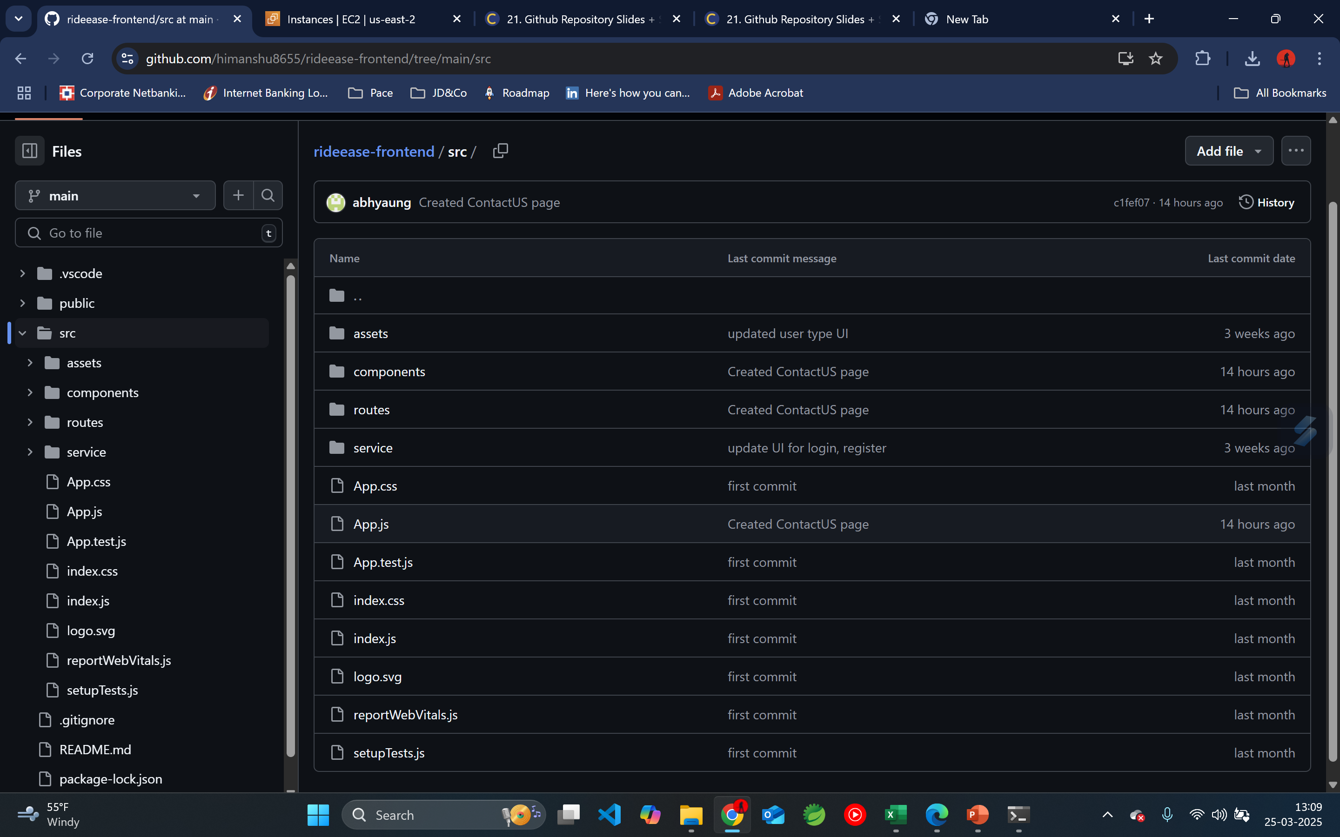
Project Structure

Slide 3
